Slide 1
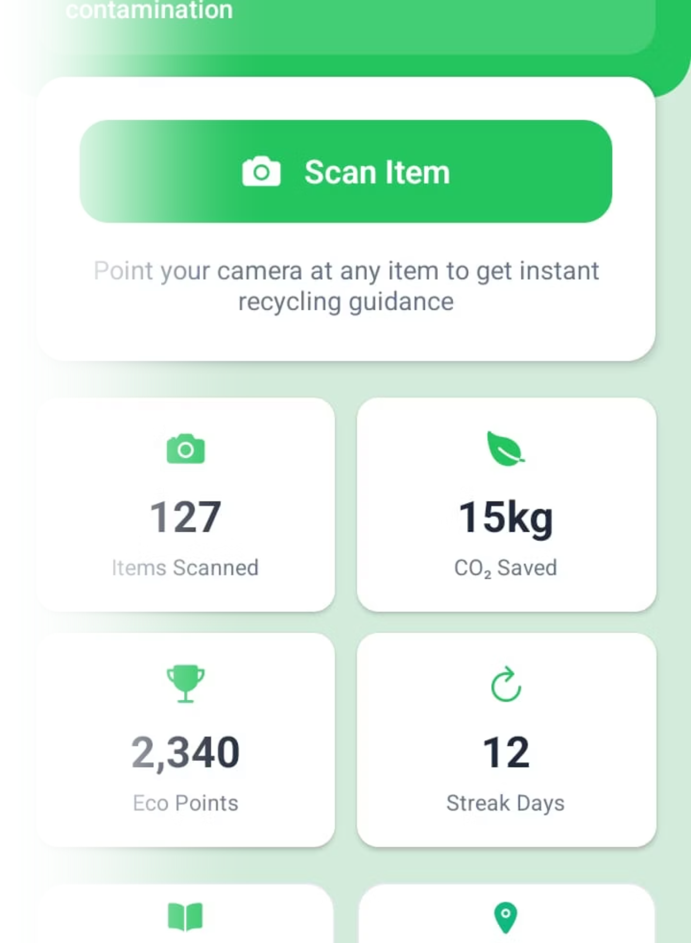
EcoSort
By- Guided By
Aagam Dangi [22100BTCSFBI11294] Prof. Vishwas DIxit
Divyanshu Kushwah[22100BTCSFBI11306]
Harsh Mandge [22100BTCSFBI11308]
Palkesh Shrivas[22100BTCSFBI11316]

Slide 2



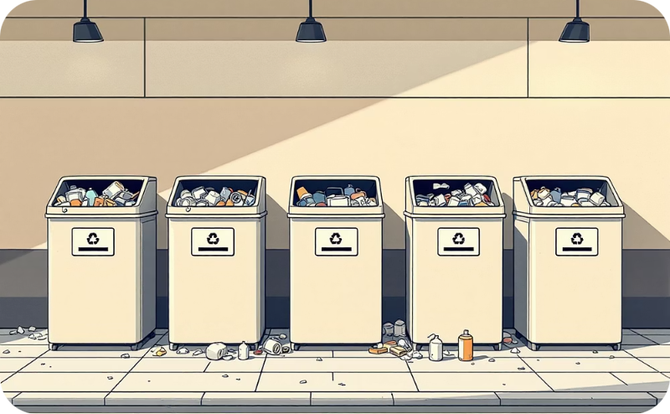
Problem Domain
Contaminated Recycling
Lack of Awareness
Overflowing Landfills
Ineffective Systems
Many individuals lack clear knowledge about what can and cannot be recycled, leading to confusion.
Existing waste management systems, including bins and labels, are often confusing and underutilized.
Improper waste segregation leads to contamination in recycling streams, reducing effectiveness.
Rapidly increasing landfill waste contributes to environmental pollution and resource depletion.

Slide 3




Solution Domain
EcoSort: AI + AR mobile app for real-time waste classification
Camera scans item → AI model predicts recyclability.
AR overlays provide step-by-step recycling guidance.
App shows nearest recycling centers and proper disposal methods.
Gamification & analytics to motivate eco-friendly behavior.

Slide 4
Functional Requirements (What the System Does)
Detects and classifies items (plastic, paper, metal, glass, organic).
1
Displays recycling instructions through AR visualization.
2
Tracks user history, stats, and eco-contributions.
3
Provides map-based recycling center locator.
4
Rewards users with points, badges, and progress reports.
5

Slide 5
Non-Functional Requirements (How the System Performs)
1
High accuracy of classification (AI-powered).
2
Real-time response with minimal delay.
3
Cross-platform availability (Android & iOS).
4
Scalable backend with secure database.
5
Easy-to-use interface for all age groups.

Slide 6





Conceptual Design: System Overview
Frontend (React Native): Mobile interface with AR support.
Backend (Python + APIs): Handles AI inference and data flow.
AI Model (Hugging Face / Gemini): Waste classification engine.
Database (MongoDB/PostgreSQL): Stores scans, user stats, rewards.
Cloud Hosting (AWS/Firebase): Ensures scalability & real-time sync.

Slide 7

Level 0 Data Flow Diagram

Slide 8
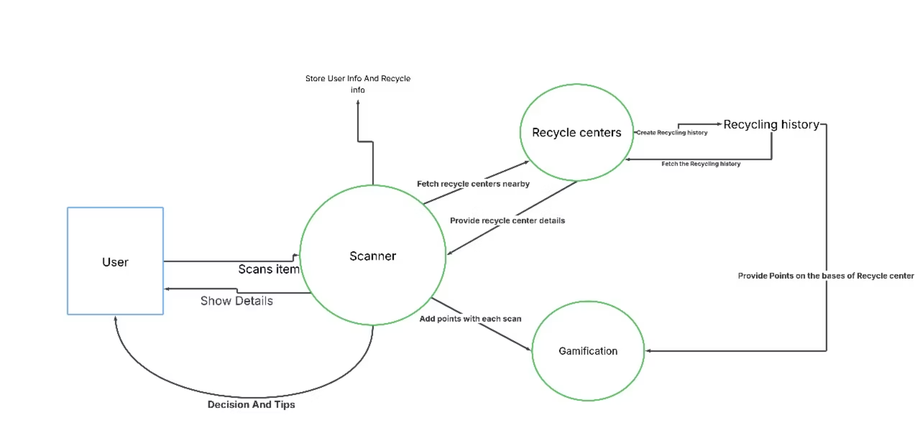
Level 1 Data Flow Diagram

Slide 9
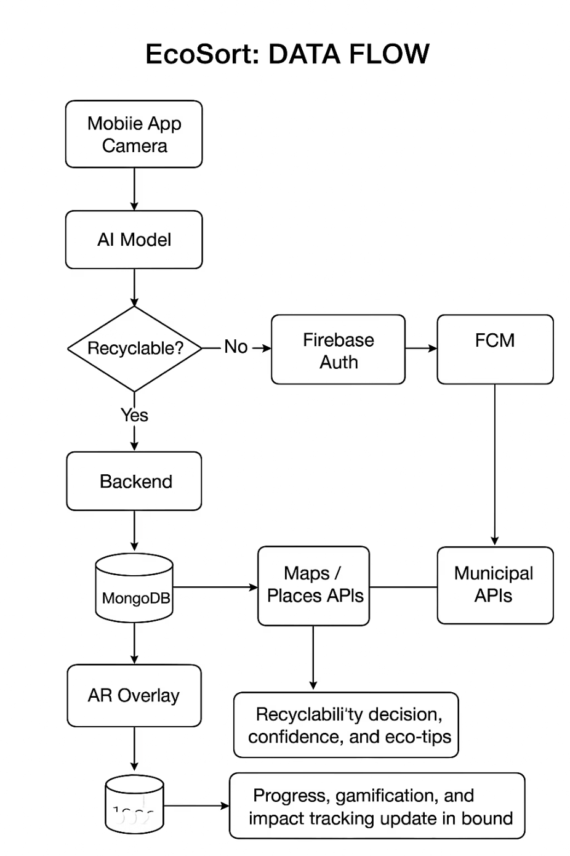
Level 2 Data Flow Diagram

Slide 10
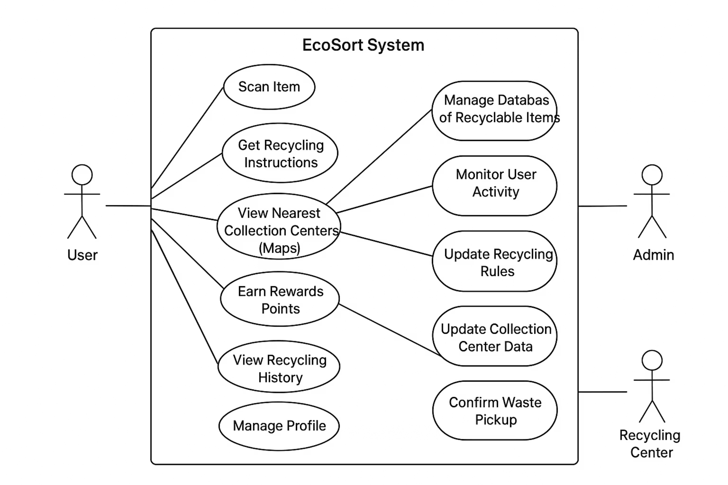
Use Case Diagram

Slide 11






Conceptual Design: Data Flow
User scans item with mobile camera.
Image sent to AI model for classification.
AI returns result (Recyclable/Non-recyclable + category).
Backend combines AI output + recycling rules.
Data stored in database (history + rewards).
User receives AR guidance + nearest recycling center info.

Slide 12
Conceptual Design: Key Modules
AI Module: Image classification.
AR Module: Visualization of recycling info.
User Module: History, rewards, eco-tracking.
Maps Module: Nearest recycling centers.
Database Module: User data, scans, analytics.

Slide 13










Conceptual Design: User Interaction
Open app → Scan item using camera.
Get instant recyclability result with AR overlay.
View recycling instructions + nearest center.
Earn points for eco-friendly actions.
Track progress & compare on leaderboard.

Slide 14




Conclusion
EcoSort bridges the gap between waste disposal and recycling awareness.
Combines AI, AR, and gamification into one eco-friendly tool.
Helps individuals, communities, and smart cities adopt sustainable practices.
A practical step toward reducing landfill waste and protecting the environment.

Slide 15

Thank You

